Slide 1
Cell based architecture
12 September 2024

Slide 2
Agenda
01
What is cell based architecture
02
Why and when to use cell based architecture.
03
Implementation of cell based architecture.
04
Best Practices .

Slide 3
Intro
Plan to add my profile overview .
Solution Architect II

Slide 4
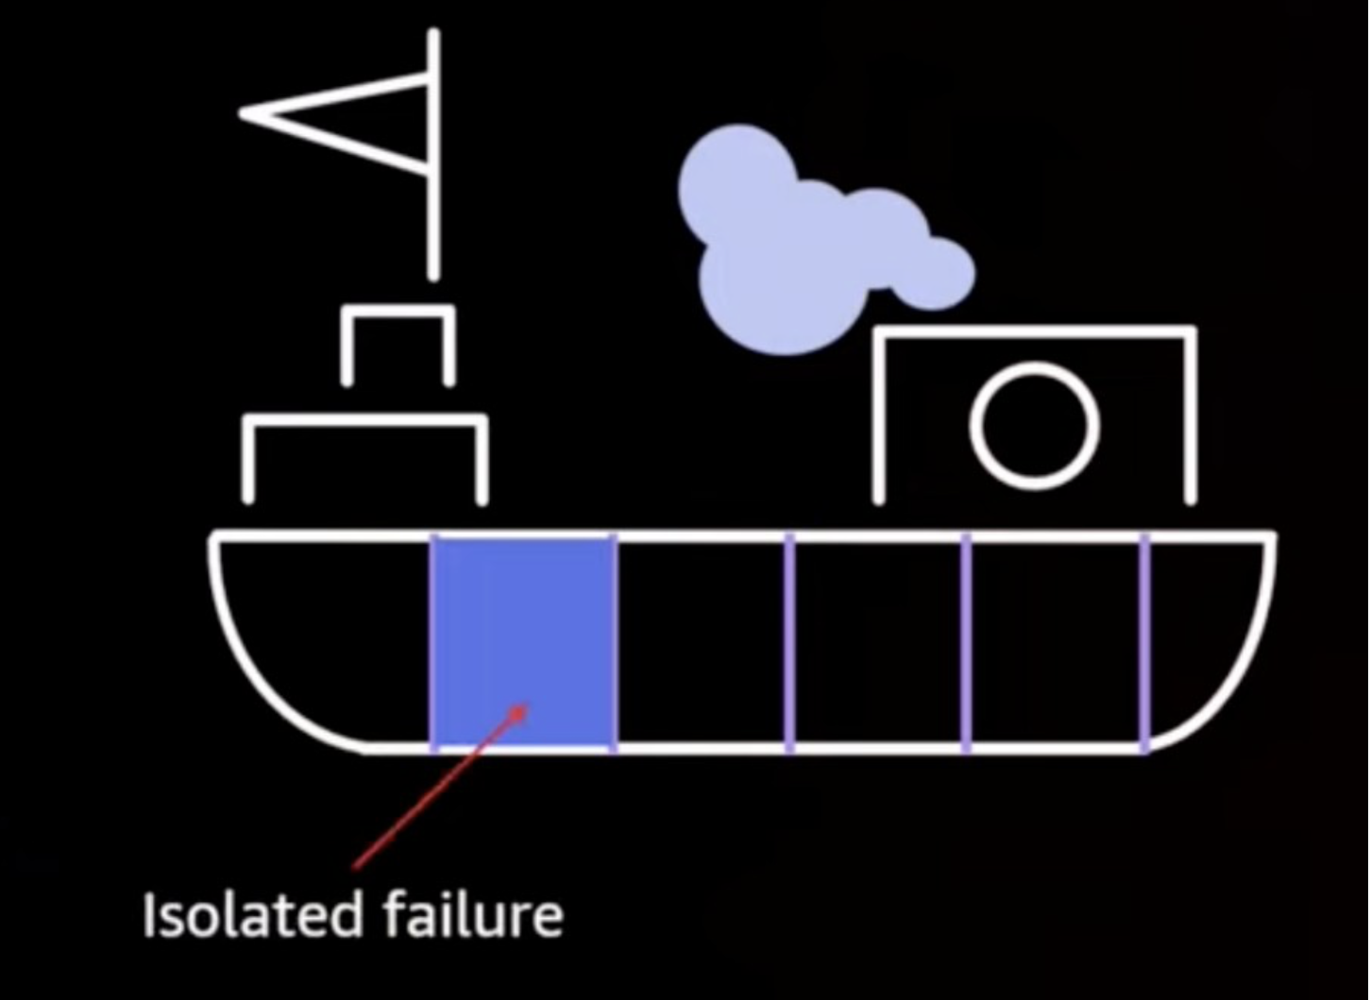
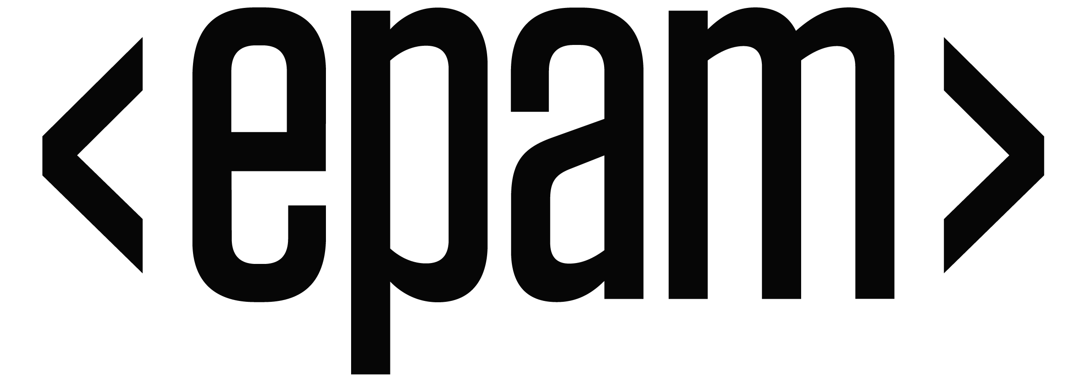
What is Cell based architecture
Cell based architecture introduction
A cell-based architecture comes from the concept of a bulkhead in a ship, where vertical partition walls subdivide the ship's interior into self-contained, watertight compartments. Bulkheads reduce the extent of seawater flooding in case of damage and provide additional stiffness to the hull girder.
On a ship, bulkheads ensure that a hull breach is contained within one section of the ship. In complex systems, this pattern is often replicated to allow fault isolation. Fault isolated boundaries restrict the effect of a failure within a workload to a limited number of components. Components outside of the boundary are unaffected by the failure.

Slide 5
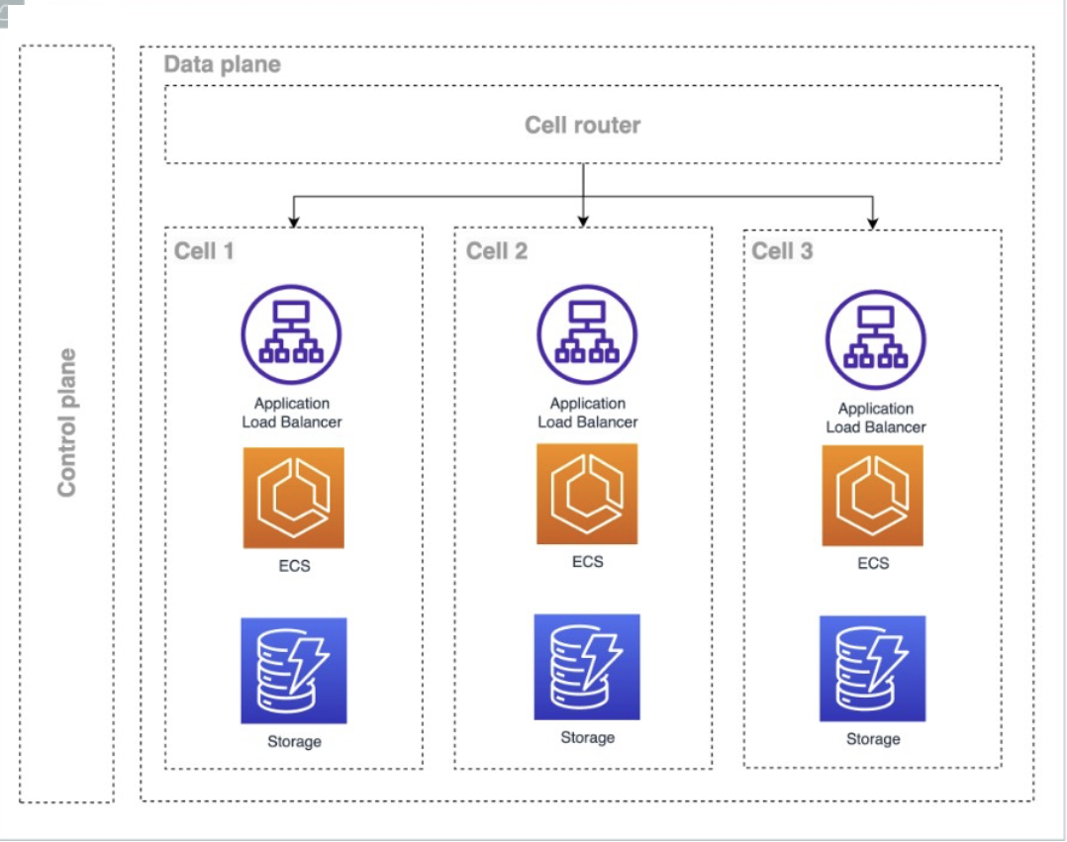
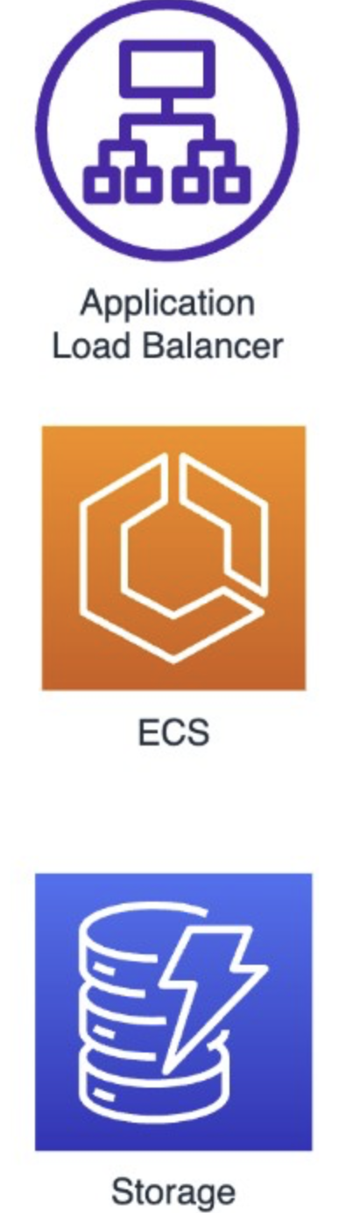
Cell based architecture
A Typical Workload : To make it clearer, in the following first diagram, we have a typical application divided into three layers. In this context, this application would be serving requests from 100% of clients. In the event of a failure, or a change in the application, 100% of customers would be impacted
A Workload with cell- based architecture : To make it clearer, in the following second diagram, Rather than build out services as single-image systems, we propose a different approach: break your services down internally into cells and build thin layers to route traffic to the right cells. This type of architecture can be zonal, regional, or global

Slide 6
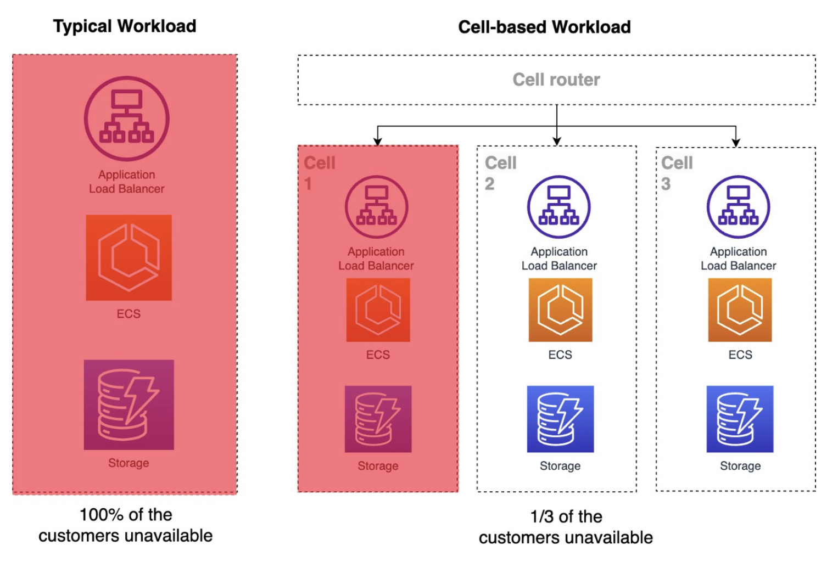
Why use a cell-based architecture?
Cell based architecture
Lower scope of impact
Breaking a service up into multiple cells reduces the scope of impact. Cells represent bulkheaded units that provide containment for many common failure scenarios. When properly isolated from each other, cells have failure containment similar to what we see with Regions. It's highly unlikely for a service outage to span multiple Regions. It should be similarly unlikely for a service outage to span multiple cells.

Slide 7
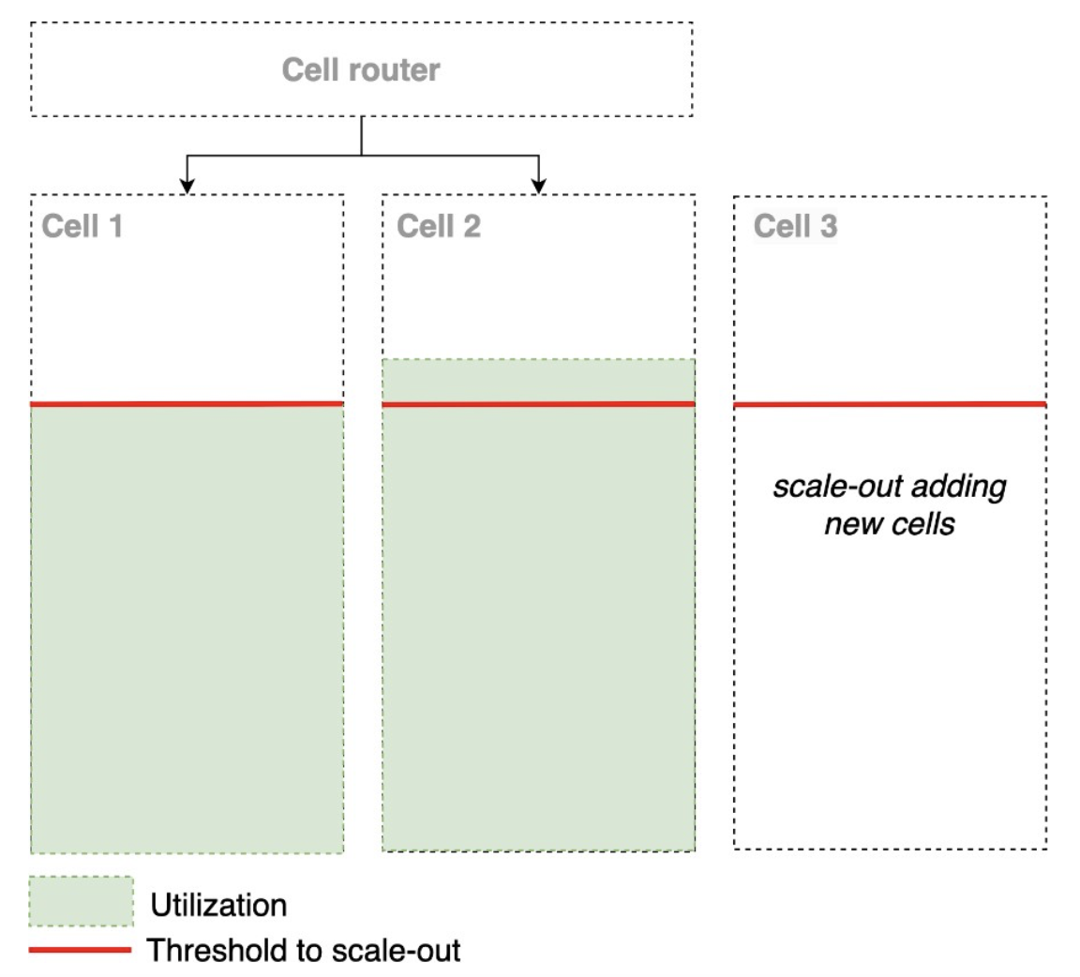
Cell based architecture
Higher scalability or cells as a unit scale
in the Well-Architected Framework, for your workloads, defining, testing, and managing the limits and capacity of a cell is also essential. Knowing and monitoring this capacity, it's possible to define limits, and scale your workload by adding new cells to your architecture, thus scaling it out.
Cell-based architectures scale-out rather than scale-up and are inherently more scalable. This is because when scaling up, you can reach the resource limits of a particular service, instance, or cloud account. However, scaling out your workload within an Availability Zone, Region, and AWS account, you can avoid reaching the limits of a specific service or resource. When building cells with a fixed size and known and testable limits, it is possible to add new cells that are in accordance with the limits of the same cited resources.

Slide 8
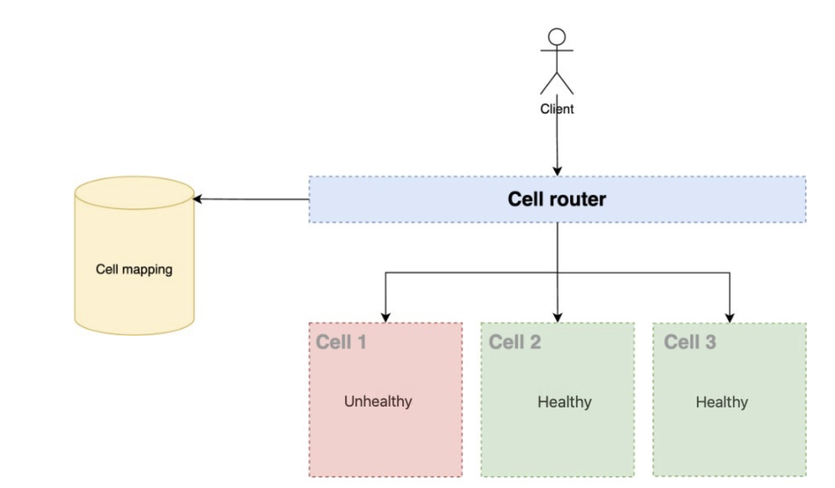
For the router layer, it's recommended that you distribute requests to individual cells using a partition mapping algorithm in a computationally efficient manner, such as combining cryptographic hash functions and modular arithmetic to map partition keys to cells. To avoid multi-cell impacts, the routing layer must remain as simple and horizontally scalable as possible, which necessitates avoiding complex business logic within this layer. This has the added benefit of making it easy to understand its expected all behavior Key Considerations for Designing the Cell Router: 1)Keep the design as simple as possible, but not overly simplistic. 2)Ensure request dispatching is isolated between cells. 3)Minimize business logic within this layer. 4)Abstract the underlying cellular implementation and complexity from clients. Prioritize speed and reliability. 5)Maintain normal operations in other cells, even if one cell becomes unreachable.
Cell routing

Slide 9
When to use a cell-based architecture?
Cell based architecture
There are applications that serve such a large number of customers that interruption of all customers is unacceptable, either for reputation, or financial reasons, where every unavailable second has a big impact. Workloads that have the following characteristics can benefit from a cell-based architecture:
Applications where any downtime can have a huge negative impact on customers.
FSI customers with workloads critical to economic stability.
Ultra-scale systems that are too big/critical to fail.
Multi-tenant services where some tenants require fully dedicated tenancy (meaning, their own dedicated cell).
Couple of Disadvantages
Implementing a cell-based architecture is not a simple task:
Increase in the complexity of the architecture due to the redundancy of infrastructure and components.
High cost of infrastructure and services, although utilization-based fee structures like Amazon EC2 Reserved Instances (RIs) and saving plans help close this delta.
Requires specialized operational tools and practices to operate these multiple replicas (cells) of the workload.
Necessity to invest in a cell routing layer.

Slide 10
Best practices
Cell based architecture
Your current instance/stack is your cell zero
When starting to plan your migration to a cell-based architecture, consider your current stack as cell zero. Adding the router layer above and little by little distributing your workload traffic according to your cell and cell partition strategy.
Start with multiple cells from day one
Since the cell is a replica of your workload to handle a portion of your customers, keep in mind from day 1 to have more than one cell. This will bring you the adverse issues and experience needed to operate in this type of environment, reducing surprises
Start with a cell migration mechanism from day one
Migrating clients from one cell to another is a tricky topic, depending on the nature of your workload it may require a lot of coordination and orchestration. Have that in mind from day one. So even if a customer quickly becomes too big for a cell, or the cell size you initially set isn't ideal, you have the mechanism to move your customers to other cells.
A few organizations that use cell-based architecture today include Amazon, Netflix, Spotify, and LinkedIn

Slide 11
Questions

